Slide 1
Decoupled, Low-Noise Power Supply
Simon Blanch, Hari Stoyanov, Henry Yuan
Notes:
Hari

Slide 2

Motivation:
“Dirty”
“Clean”
Sample
Condensed matter experimental labs:
Extremely small analog electronic signals
Amplifier
Wall power
Notes:
S

Slide 3
Motivation:
“Dirty”
“Clean”
Sample
ADC
Amplifier
DAC
Wall power
Notes:
S

Slide 4
Motivation:
“Dirty”
“Clean”
Sample
ADC
Amplifier
DAC
Wall power
Notes:
S

Slide 5
Motivation:
“Dirty”
“Clean”
Sample
Ultra clean power for instrumentation
ADC
Amplifier
DAC
Our project
Wall power
Notes:
S

Slide 6
Current^{(ha ha ha)} situation
Battery
Low noise
Has to be charged
Dangerous failure mode
Regular DC power supply
Noisy
Notes:
Henry

Slide 7

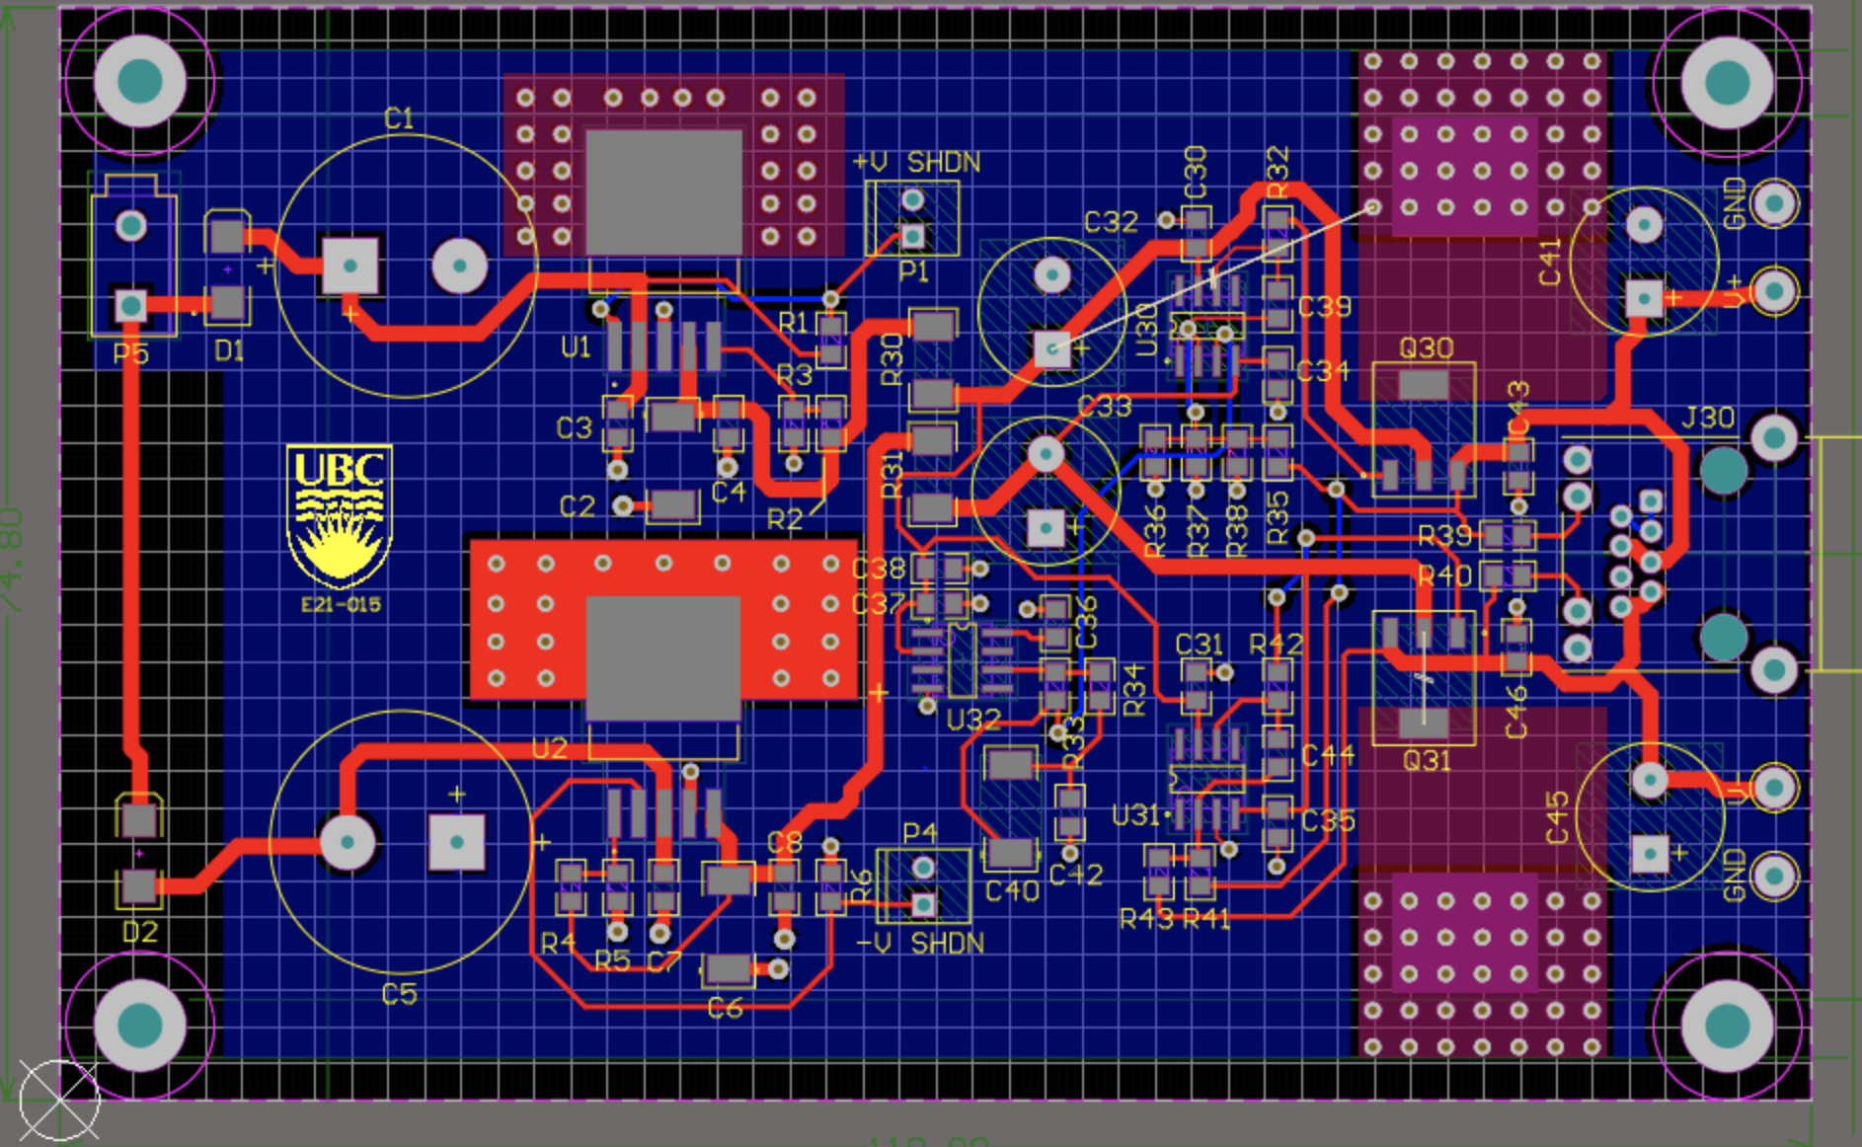
What should our setup do?
Transformer:
Step down
Eliminate direct ground connection
Eliminate common-mode noise
Our power supply circuit:
Output: low noise ±12 or 15V DC
Based on a design in use at UBC
(+UCSB)
Notes:
HENRY

Slide 8
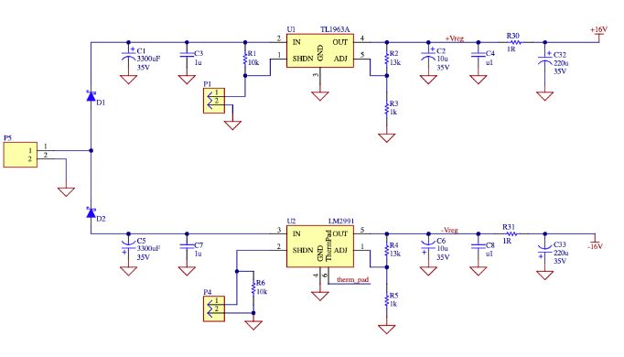
Schematic (Stage 1)
16 VAC, 60 Hz
Notes:
Henry

Slide 9
Schematic (Stage 1)
Notes:
Henry

Slide 10
Schematic (Stage 1)
Notes:
Henry

Slide 11
Schematic (Stage 1)
Notes:
Henry __> Simon

Slide 12
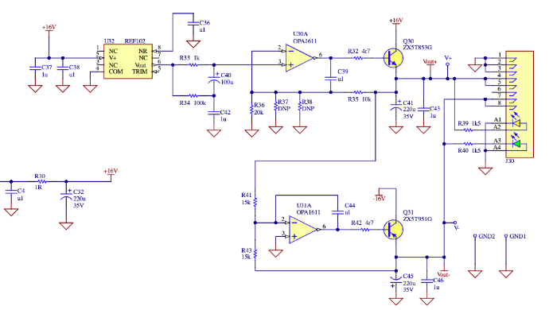
Schematic (Stage 2)
Notes:
Simon

Slide 13
Schematic (Stage 2)
Notes:
Simon

Slide 14
Schematic (Stage 2)
Notes:
Simon

Slide 15
Schematic (Stage 2)
Notes:
Simon

Slide 16
Schematic (Stage 2)
Notes:
Simon

Slide 17
PCB layout
IN
OUT(+)
(+UCSB)
OUT(-)
Notes:
Simon

Slide 18
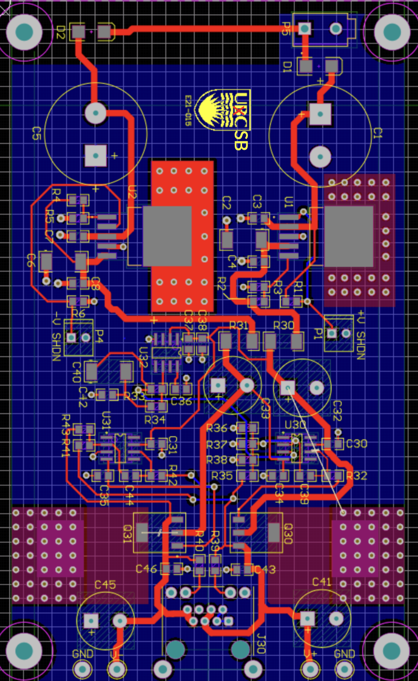
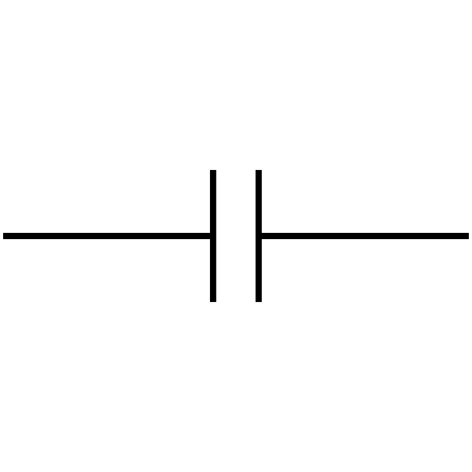
Spectrum Analyzer: Test diagram
16VAC
Wall: 120VAC
Spectrum Analyzer: Fourier transforms input signal
FFT
+/-15VDC
(CS15B, anyone?)
Notes:
Simon

Slide 19
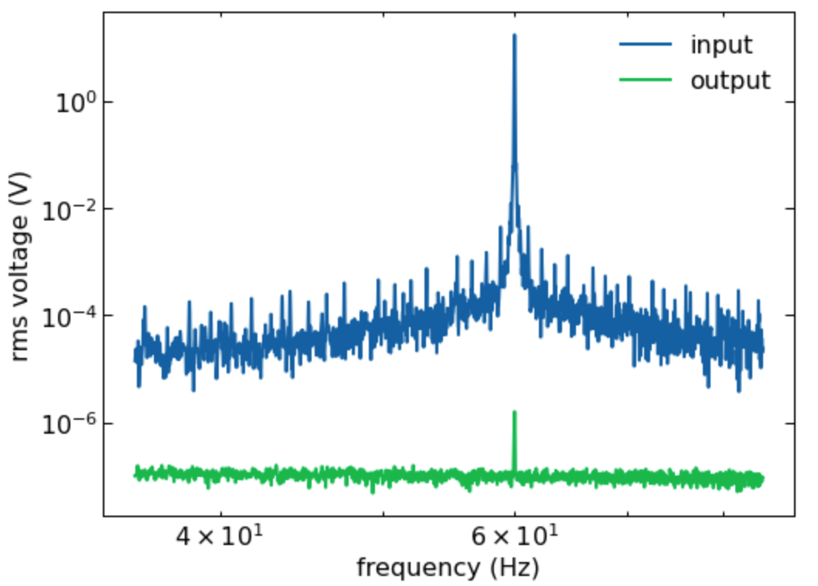
FFT around 60 Hz
Notes:
Hari

Slide 20
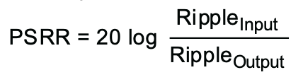
Power Supply Rejection Ratio (PSRR)
PSRR: How well does PS “reject” input voltage frequency?
Notes:
Hari

Slide 21
Power Supply Rejection Ratio (PSRR)
O
PSRR: How well does PS “reject” input voltage frequency?
PSRR for lab DC power supply (Acopian): ~98
PSRR for our supply: ~160 from wall power
O
Wall power (60 Hz)
Notes:
Hari

Slide 22
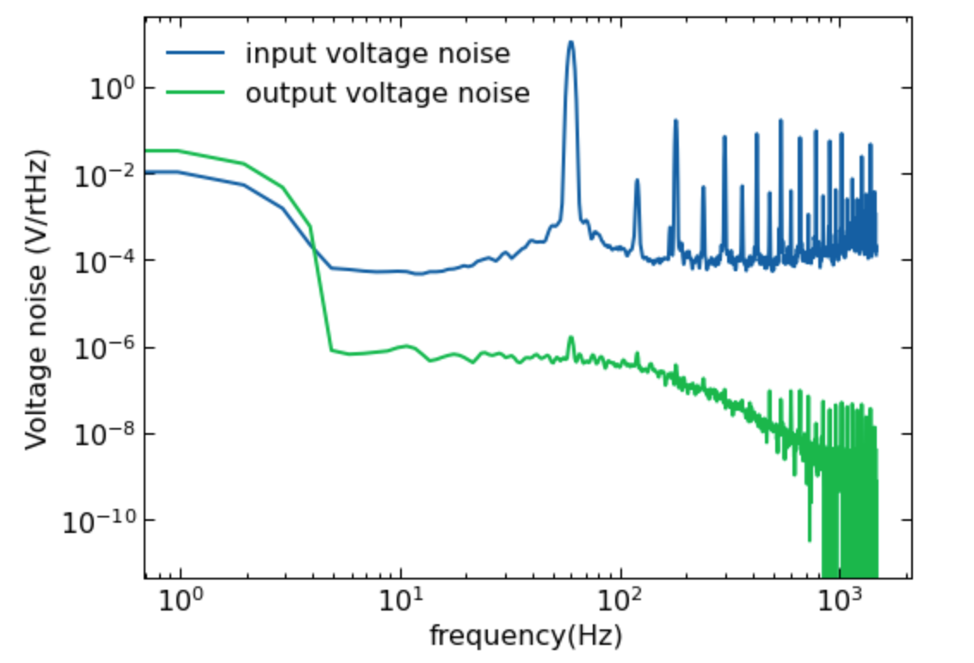
Voltage Noise Spectrum Analysis
Notes:
Hari

Slide 23
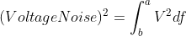
Voltage Noise Spectrum Analysis
Total input voltage noise: 0.5 V (post-transformer)
Total output voltage noise: 5.7e-6 V
Notes:
Hari

Slide 24
Looking Forward
Protective Casing: increase durability and safety
Adjustable output: different outputs for different situations
Notes:
Henry

Slide 25
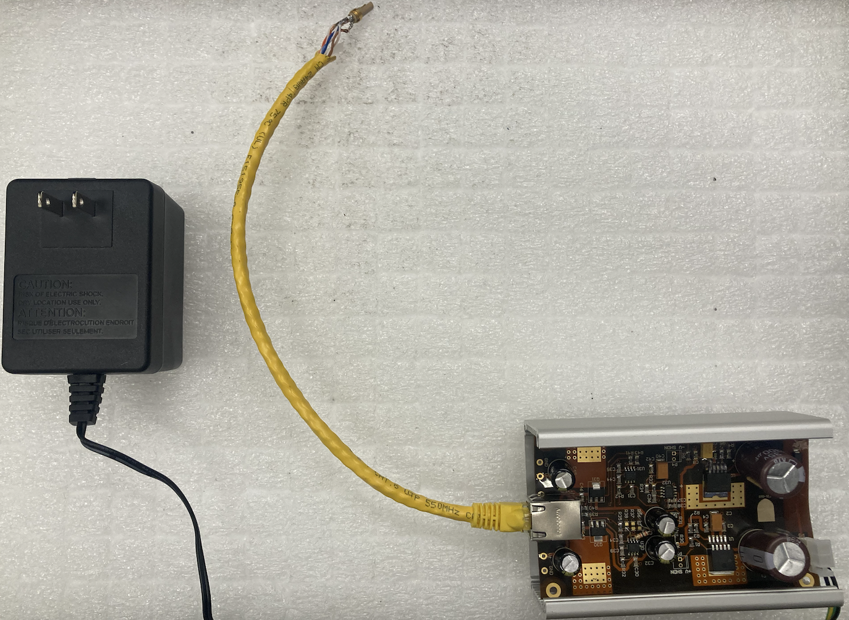
Thank you!
Notes:
Simon

